Slide 1
ANALYZING GAZEPOINT DATA BBSN 5022: Eye Tracking Methods and Dynamic Data Analysis

Slide 2
Learning Objectives
Understanding the kinds of data we get from gazepoint.
Cleaning gazepoint data.
Analyzing gazepoint data in SPSS.
Analyzing gazepoint data in R.

Slide 3
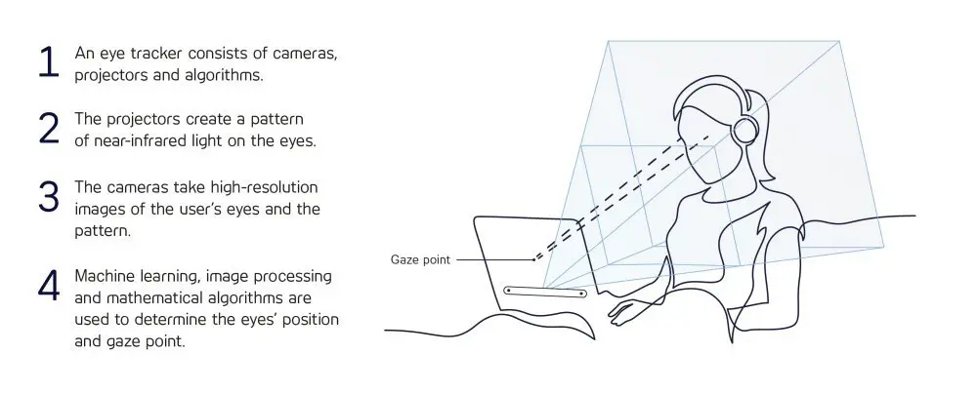
About Gazepoint
The Gazepoint Analysis system provides an easy-to-use yet powerful method for collecting and analyzing eye-gaze data.

Slide 4
Some important components of Gazepoint data collection:
Media List : The ‘Media List’ box displays a list of the stimuli you want to present during your experiment. Gazepoint Analysis allows you to utilize a wide variety of stimuli for your experiments: Images, Text files, Videos, Webpages, and Screen Captures. Can set for much time each will be presented.
Recording List: List of participants’ gazepoint data recorded for the experiment.
Area of Interest (AOI) list: To assign unique areas of interest for each stimulus (e.g., if using a website page).

Slide 5
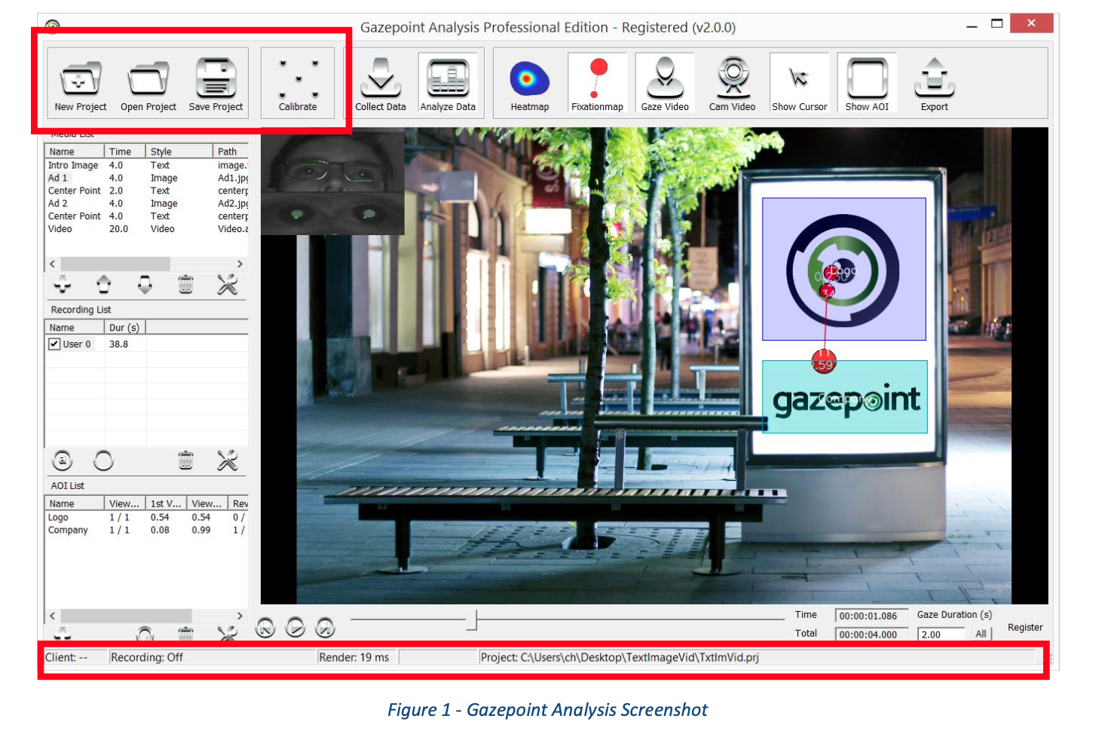

Slide 6
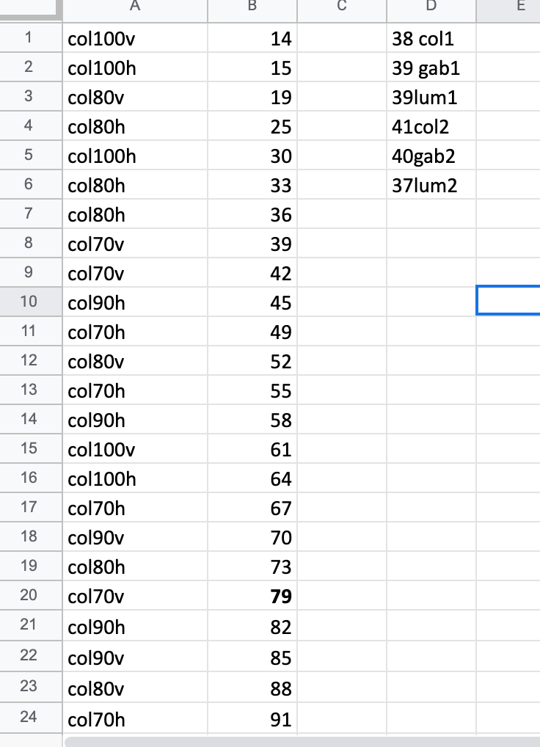
Accuracy Measurement
Participants’ key responses are recorded to assess if they accurately identified the correct orientation of the stimulus.

Slide 7
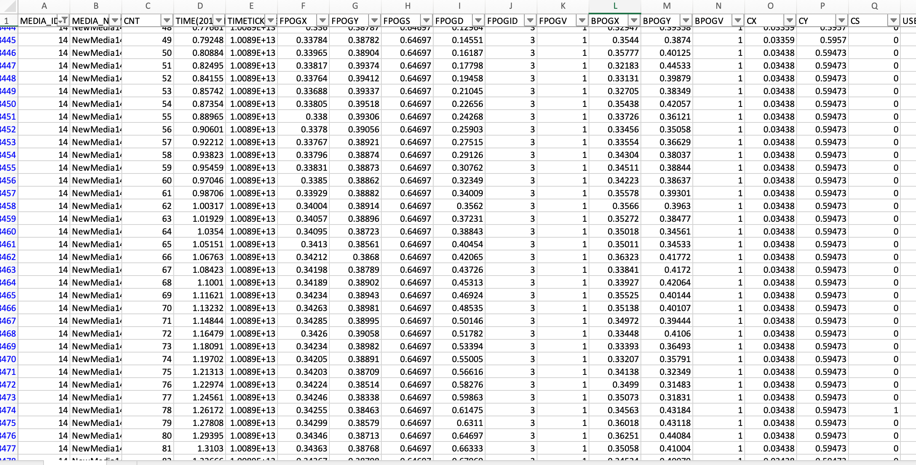
Reaction Time Calculations
Latency to key press (milliseconds)

Slide 8
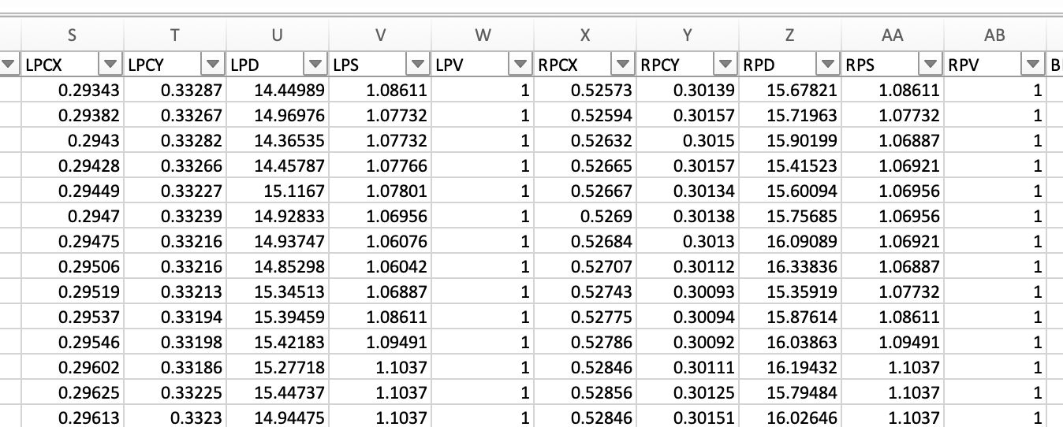
Pupillary Dilation Measurements
Pupil size delta values are attained by calculating difference of scores between the first pupil diameter data capture of each trial and the last capture prior to response.

Slide 9
Saccades & Fixations
Saccades: Calculated by collecting eye-movement data in either horizontal or vertical direction after filtering out jitter that was not part of an overall saccade.
Fixations: Points where a user looks at a specific spot for a certain amount of time. Records the x-y coordinates of where the user was looking and also measures how long they spent looking at each point.
Validity: Whether the data collected at that point is ‘valid’ (free of errors).

Slide 10
Cleaning Raw Data from Gazepoint
Notes:
Go through excel on how to clean data.

Slide 11
Analyzing the Data using ANOVAs

Slide 12
INTRODUCTION
Used to evaluate whether the mean on a particular measure (dependent variable- DV) differs between two or more groups.
Factor = Independent Variable (IV)
Levels = groups involved in an IV
For example:
Difficulty of stimulus = IV
The different difficulties (100%, 90%, 80%, 70%) = levels
IV should be categorical, DV continuous

Slide 13

TYPES OF ANOVA
One-Way ANOVA
1
One IV with more than two levels
Two-Way ANOVA
2
Two IV’s
This provides an examination of each IV and the interaction of the two IV’s on the DV
Repeated Measures ANOVA
3
One IV with more than two levels
DV measured multiple times
Mixed ANOVA
4
Two or more IV’s
DV measure multiple times

Slide 14
WHAT IS REPEATED MEASURES ANOVA?
If a set of measurements are more correlated than we would expect by chance, we must account for this correlation. We can say that these measurements come from the same ‘subject’ (in psychological terminology), or that this measure was ‘repeated’ (Cardinal and Aitken, 2006).

Slide 15
Degrees of Freedom
In statistics, the degrees of freedom (df) indicate the number of independent values that can vary in an analysis without breaking any constraints.
There are three numbers with an average of 10: 9, 12, x. What is the value of x?
Formula = n-1
In independent samples ANOVA:
Subjects in different groups are ‘independent’ of each other.
Total df is the sum of df for each group. If there are k groups with total N subjects, then total df = N-k
In repeated measures ANOVA:
The samples are related to each other, so the total degrees of freedom = degrees of freedom of one group = n-1.
Notes:
Averages examples to explain why 1 less
9

Slide 16
SPHERICITY
Homogeneity of variance of different scores.
Suppose we test 5 subjects at three levels of A.
We can therefore calculate three sets of difference scores (A3 – A2), (A2 – A1), and (A3 – A1), for each subject.
Sphericity is the assumption that the variances of these difference scores are the same.
If this assumption is violated, Type I error rates will be inflated (if the null hypothesis is true, you will get too many results that you will declare ‘significant’ than you should).
Mauchly’s test of sphericity checks for this. A significant Mauchly’s test means that the assumption is likely to have been violated.

Slide 17
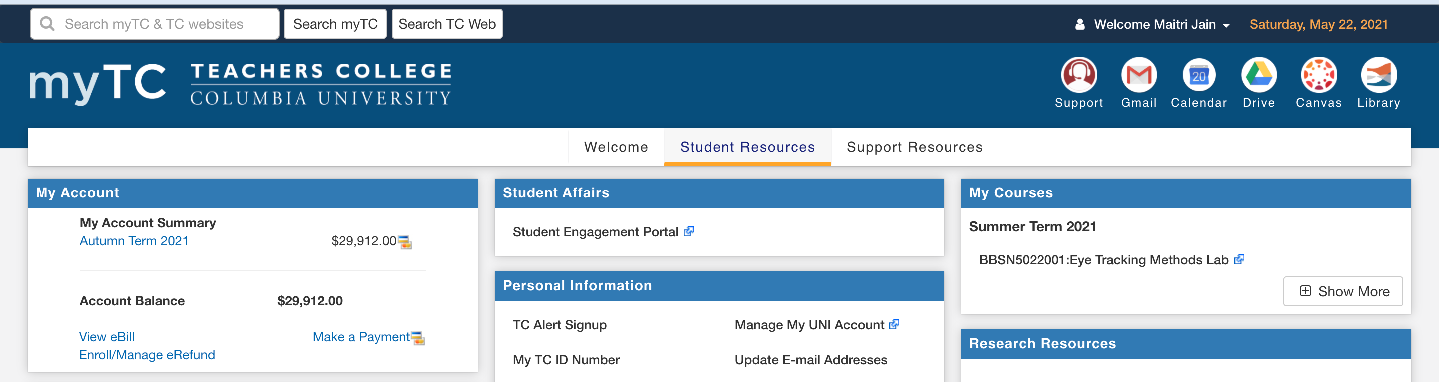
INSTALLING SPSS

Slide 18


Slide 19
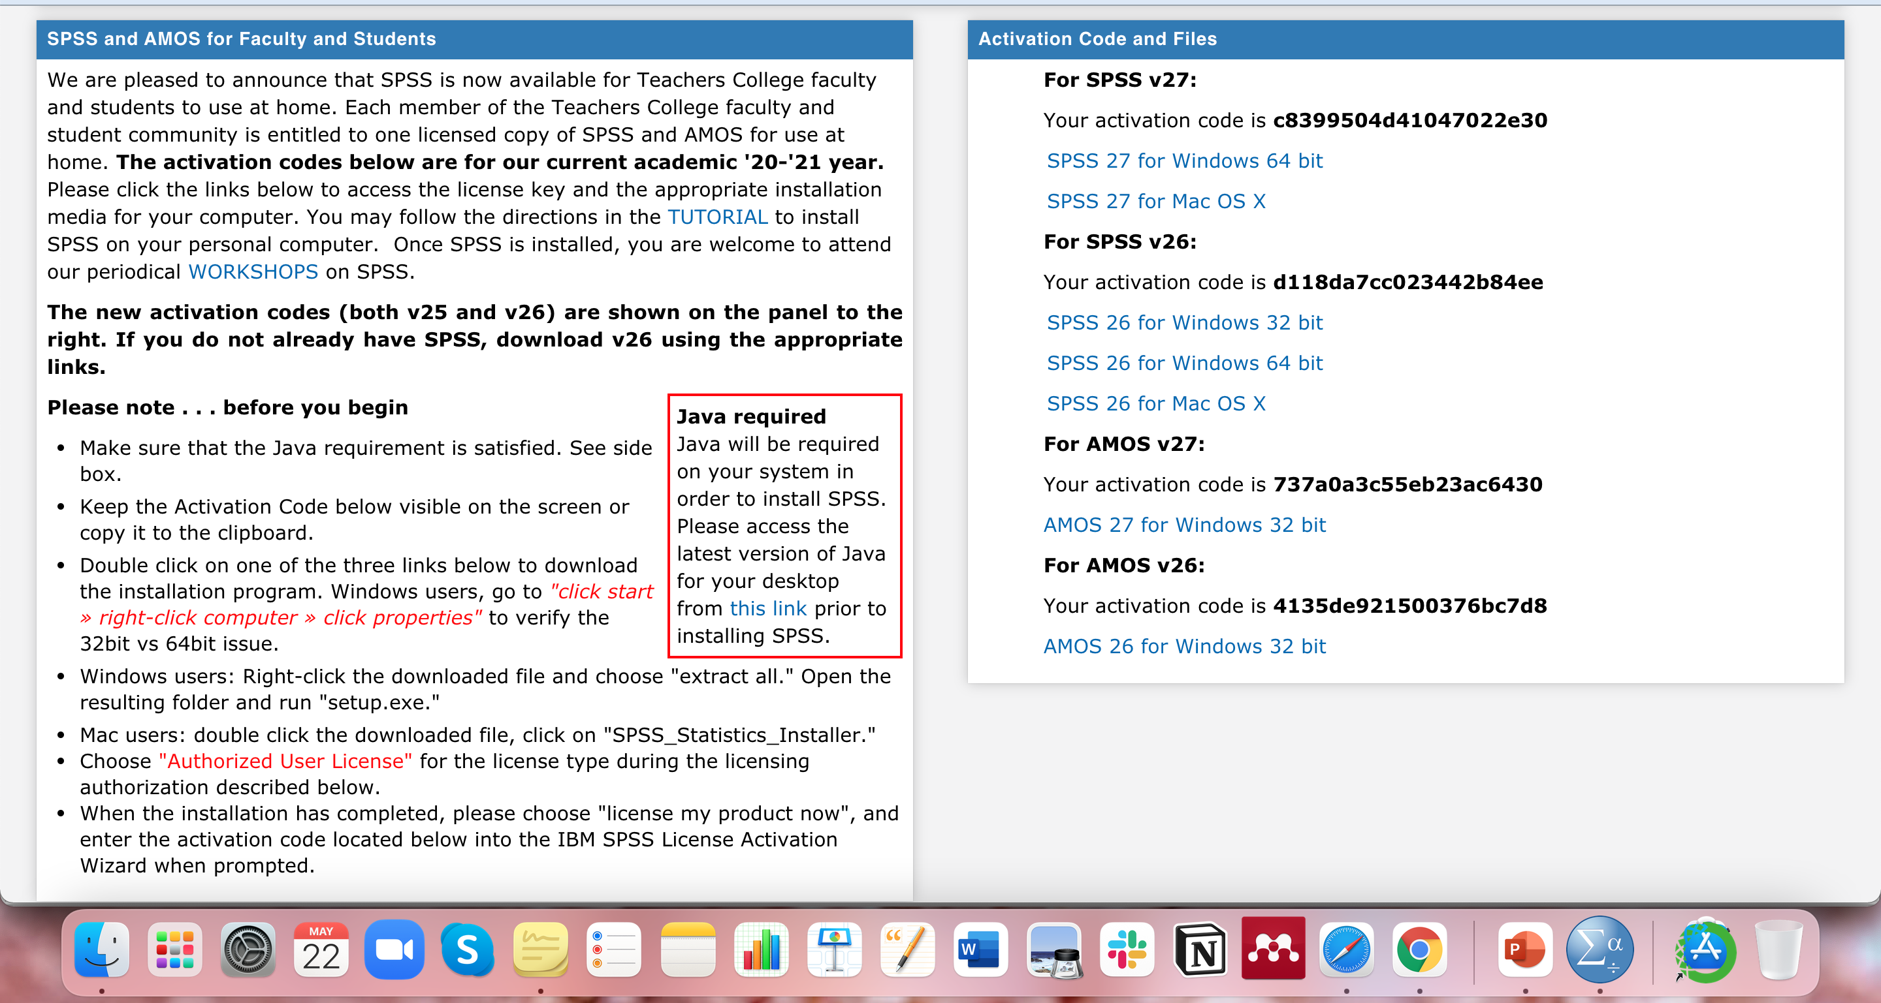

Slide 20
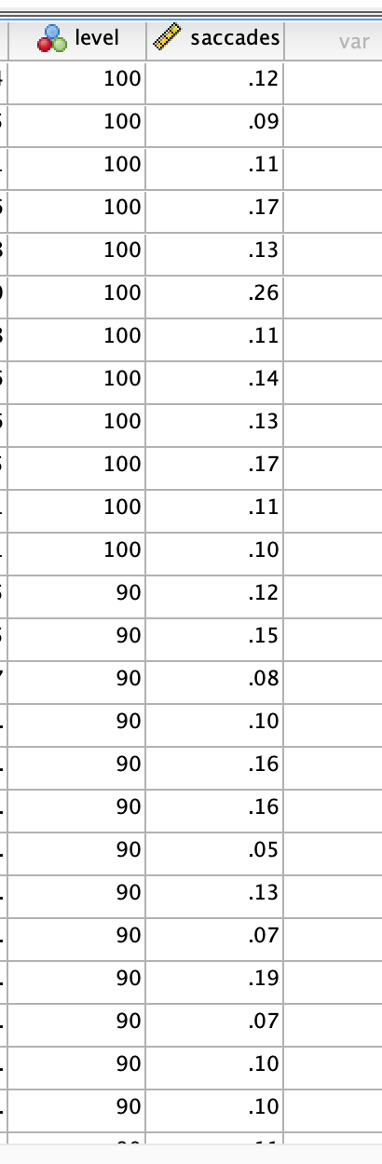
CONDUCTING REPEATED MEASURES ANOVA IN SPSS Setting up the Data

Slide 21
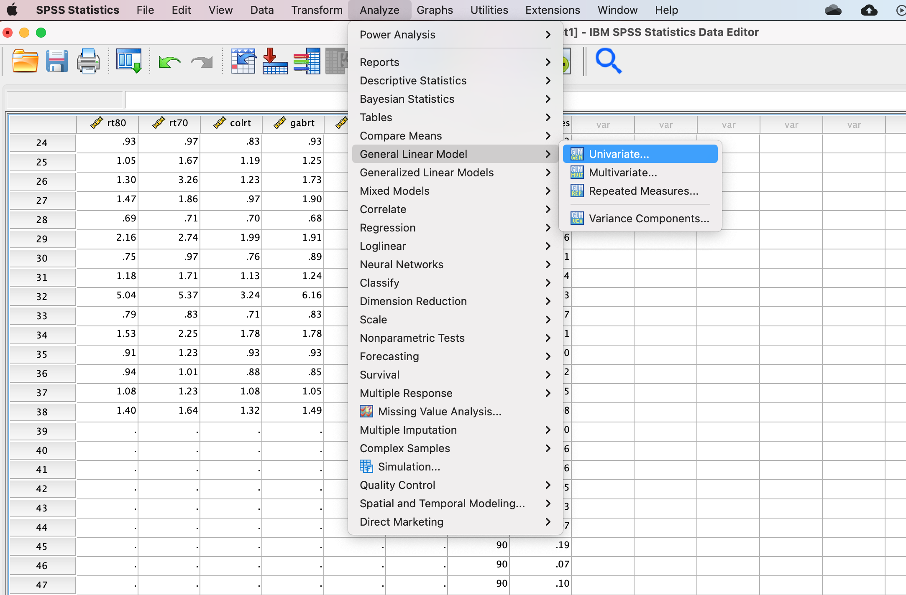
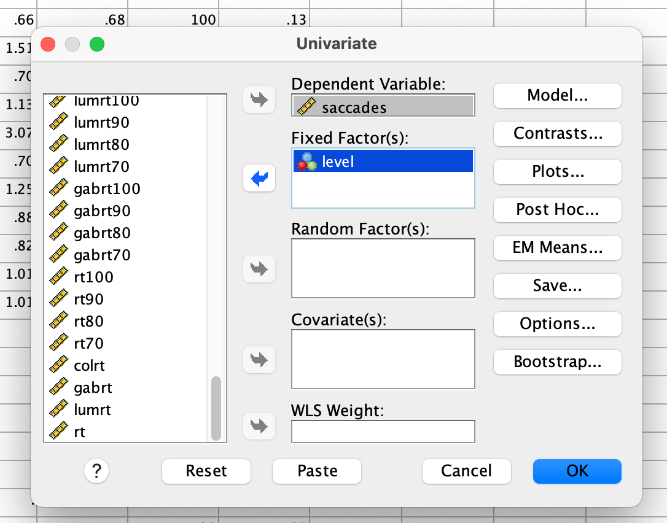
Analysis

Slide 22
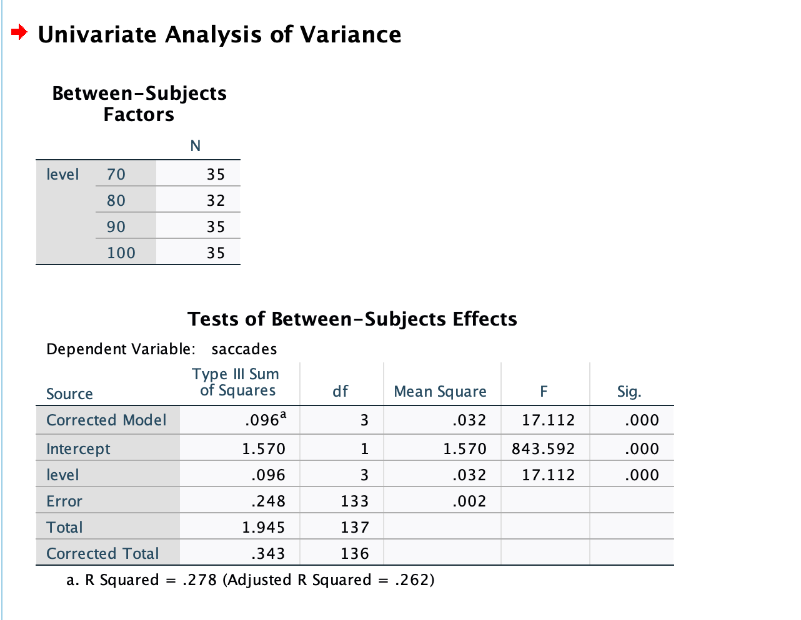
Results

Slide 23
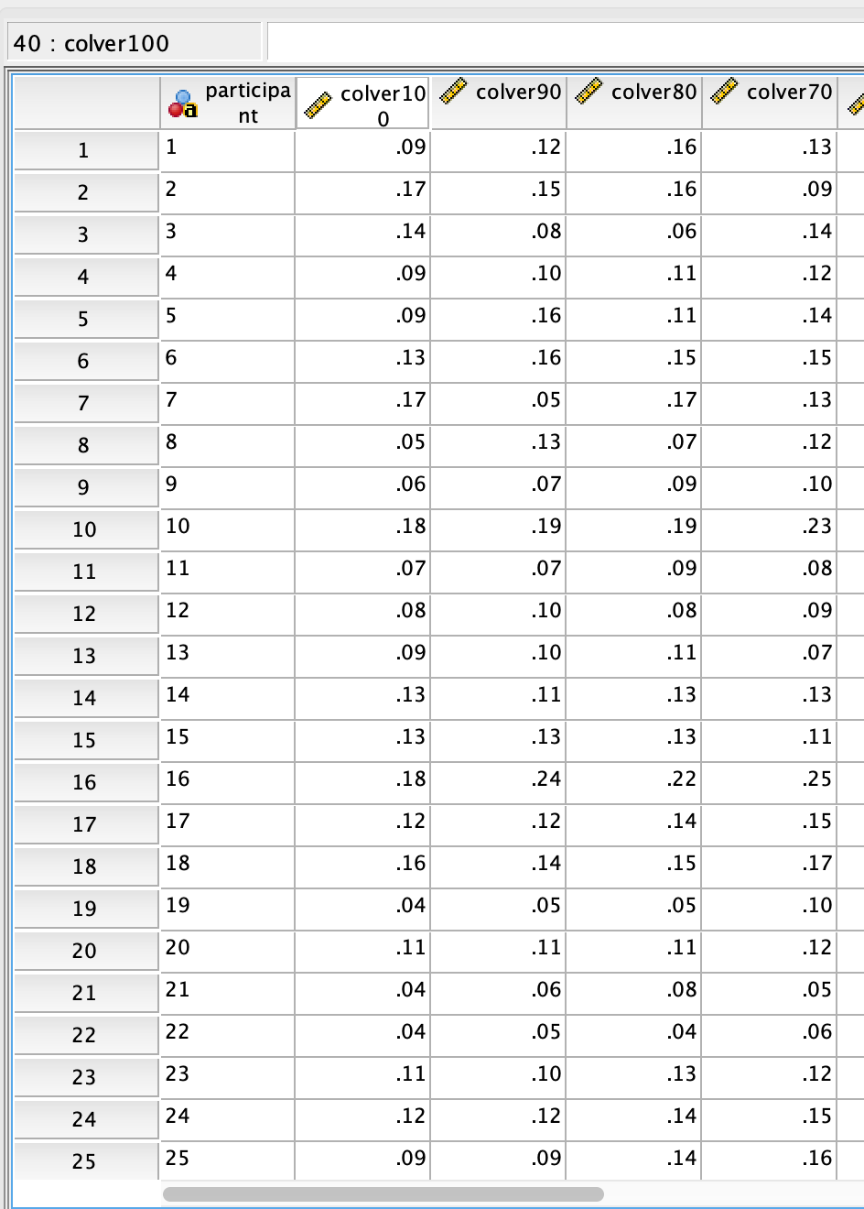
CONDUCTING REPEATED MEASURES ANOVA IN SPSS Setting up the Data

Slide 24
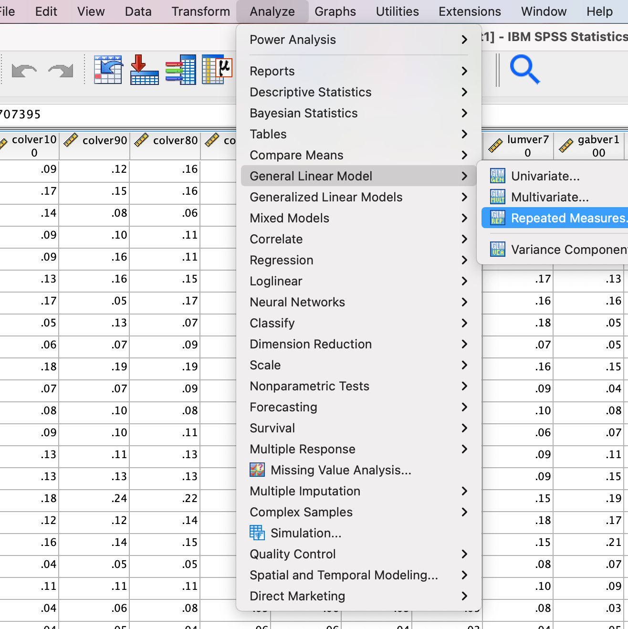
Analysis

Slide 25
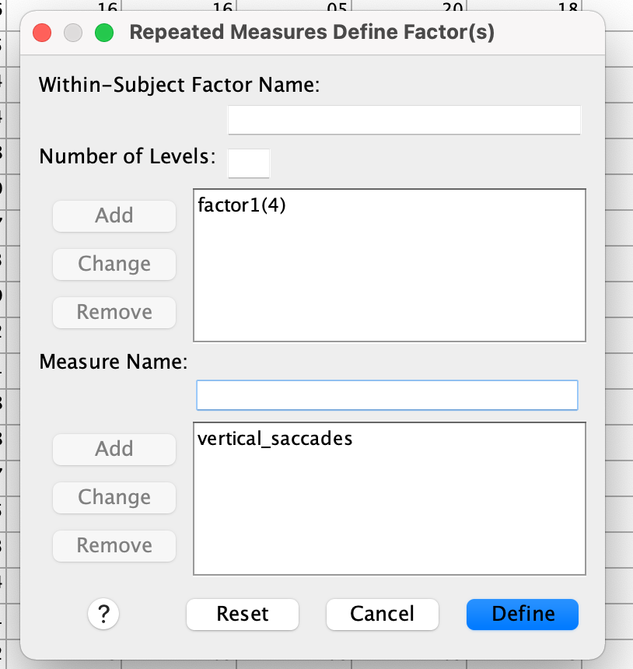
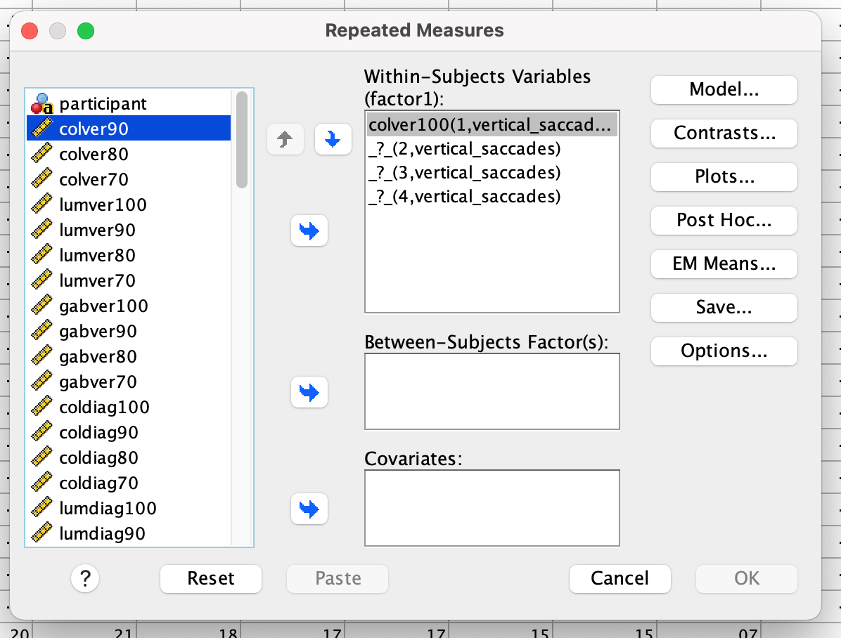
Analysis

Slide 26
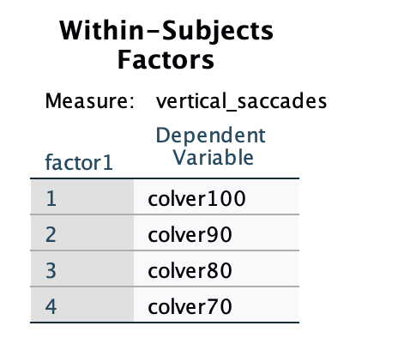
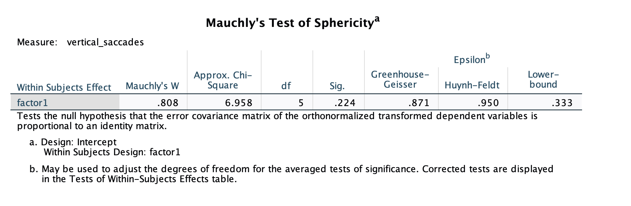
Results

Slide 27
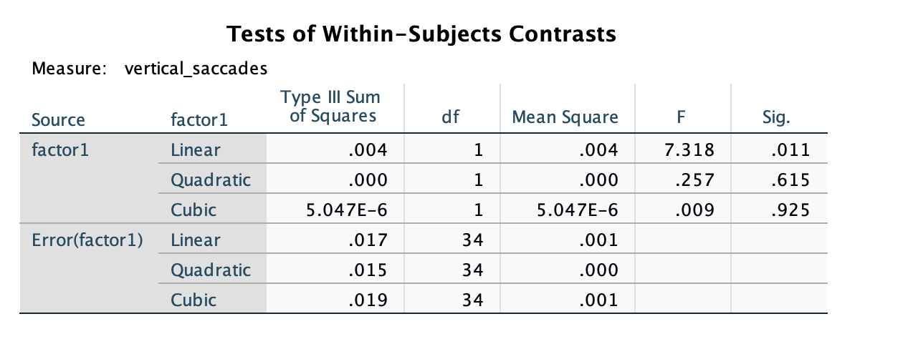
F is the ratio of the effects of IV over the error. Greater the value of F, greater are the effects of IV. When F = 1, it suggests there is nothing different between the groups.

Slide 28
Graph

